Slide 1
Information theory and criterion
Additions to Linear Models

Slide 2
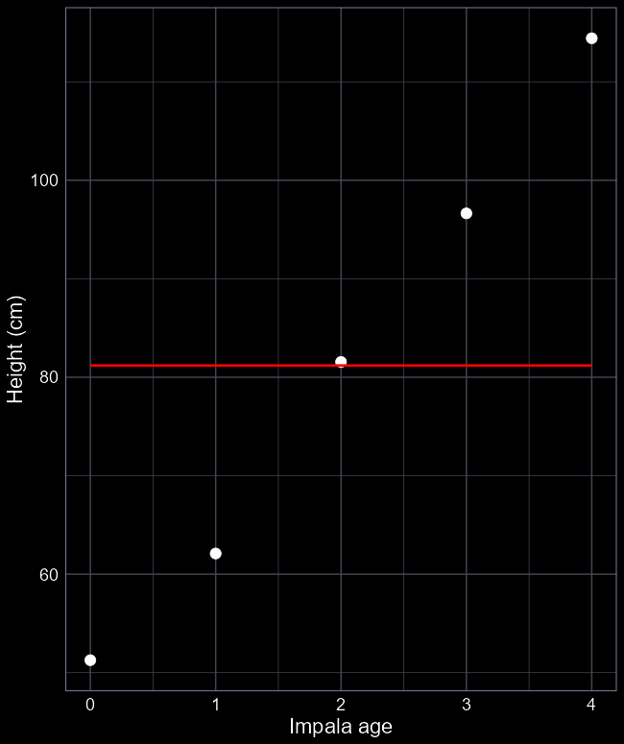
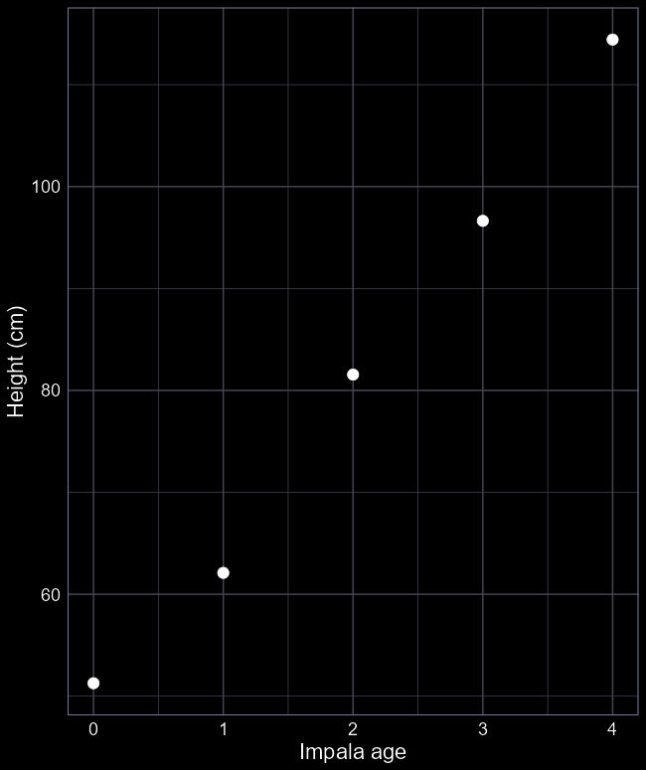
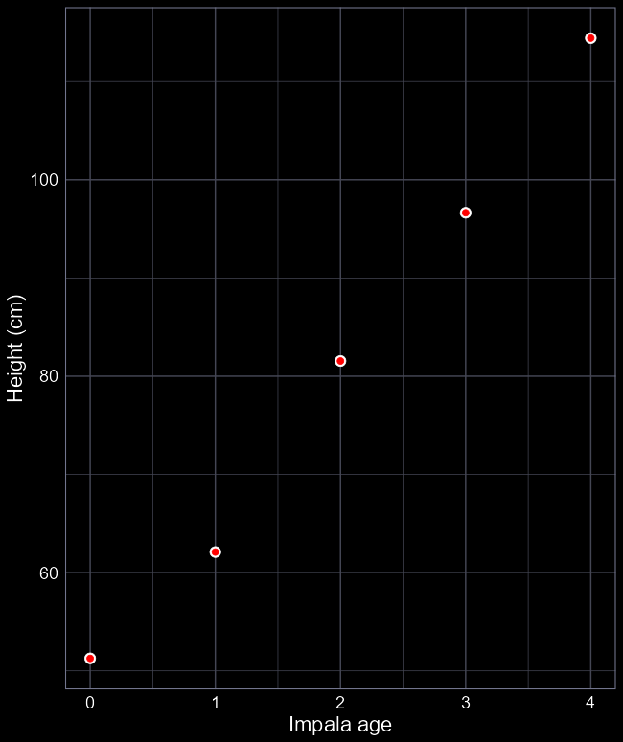
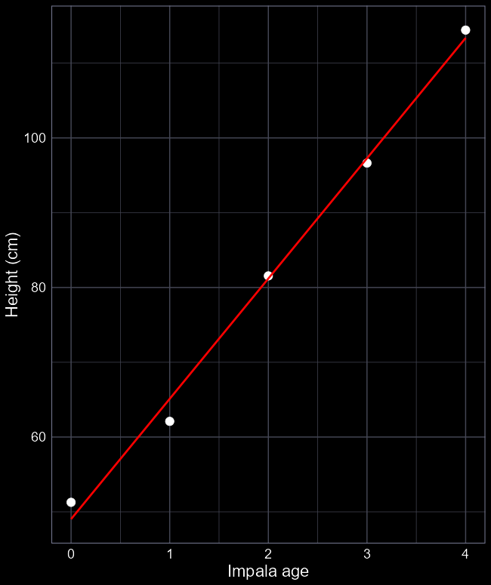
Overfitting and underfitting
We have height data of an individual impala from ages 0 to 4
Model 1:
lm(height ~ age_factor)
5 parameters
Model 2:
lm(height ~ 1)
1 parameter
Model 3:
lm(height ~ age)
2 parameters

Slide 3
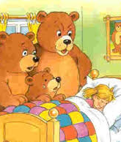

Parsimony
Overfit models:
Explains data almost “perfectly”
But “costs” lots of parameters
$μ=β_{0}+β_{1}A1+β_{2}A2+β_{3}A3+β_{4}A4$
Underfit models:
Explains data very poorly
But “costs” very few parameters
$μ=β_{0}$

Slide 4

Which model best fits our data?
When running analysis, you will invariably have multiple models (each of which reflect a different process), all trying to explain the same pattern, e.g.,
Out of all the models (i.e., processes) that we’ve run, how do we choose the most likely model?
AIC
“An Information Criteria” or “Information Criterion A”
“Improperly” called Akaike’s Information Criteria
He never named it after himself
赤池 弘次, Akaike Hirotsugu

Slide 5
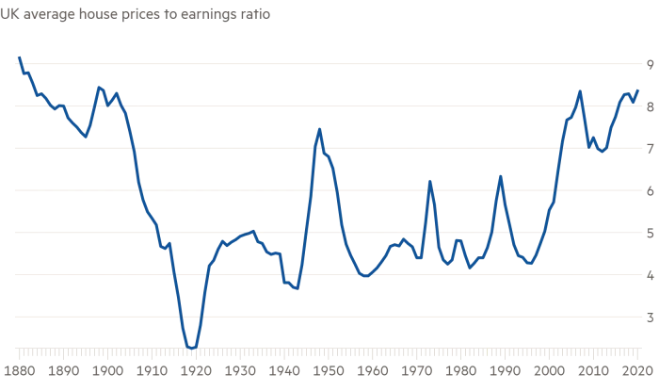
Using AIC to find most the “parsimonious” model
To do so, we use the best Likelihood (MLE) value (“rating”) for each of the different models that we’ve run.

Slide 6
Likelihood?
We’ve been using likelihood the whole course
The optimiser tries to maximise this for each set of parameters for each model
This happens for:
Model 1: lm(height ~ age_factor)
Model 2: lm(height ~ 1)
Model 3: lm(height ~ age)

Slide 7
Maximised Likelihood
Once the algorithm has finished, it tells us what the best likelihood was that it could find
So long as we use the same data to fit each model, we use the likelihood as our “rating”
But how do we deal with over- and under-fitting?

Slide 8

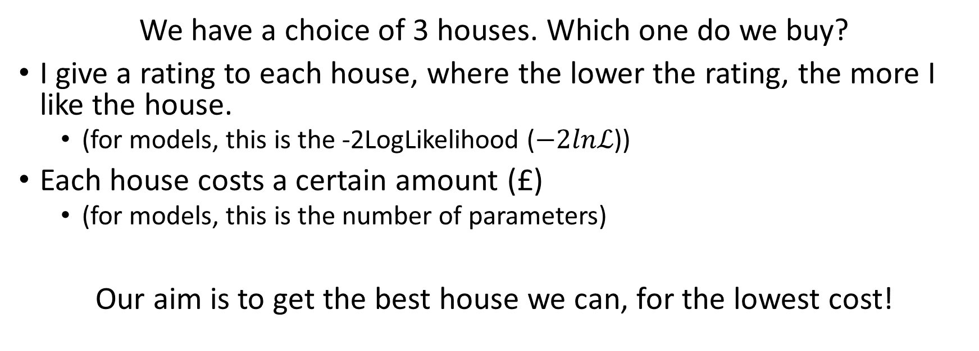
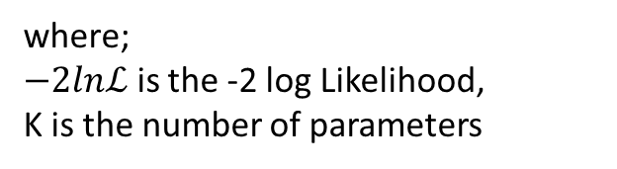
Savvy house buyers
We have a choice of 3 houses. Which one do we buy?
I give a rating to each house, where the lower the rating, the more I like the house.
(for models, this is the -2LogLikelihood ($−2lnℒ$))
Each house costs a certain amount (£)
(for models, this is the number of parameters)
Our aim is to get the best house we can, for the lowest cost!
$$AIC=−2lnℒ+2K$$
where;
$−2lnℒ$ is the -2 log Likelihood,
K is the number of parameters

Slide 9
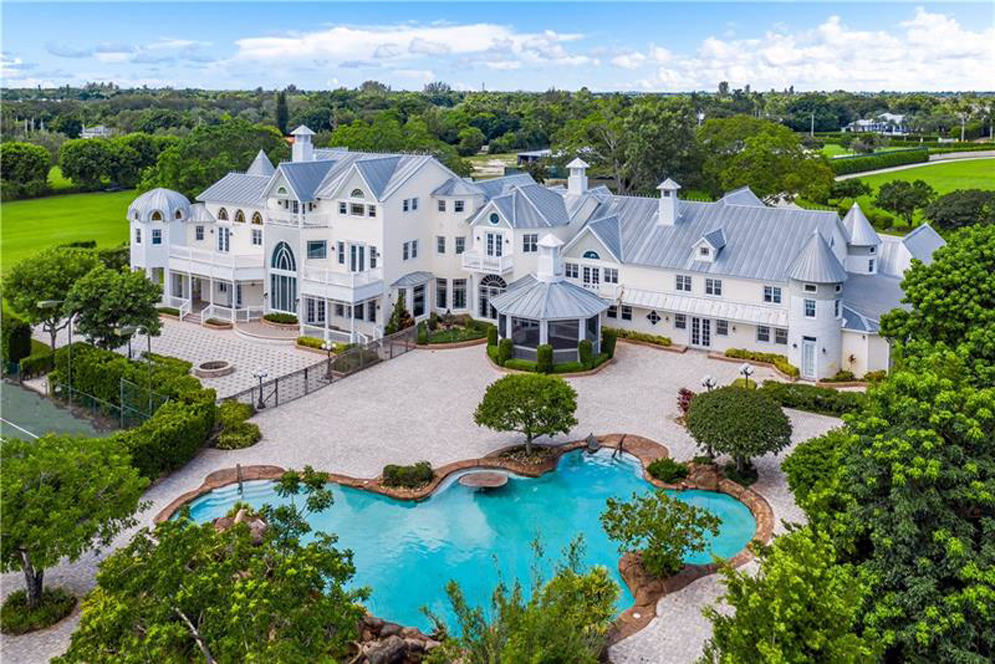
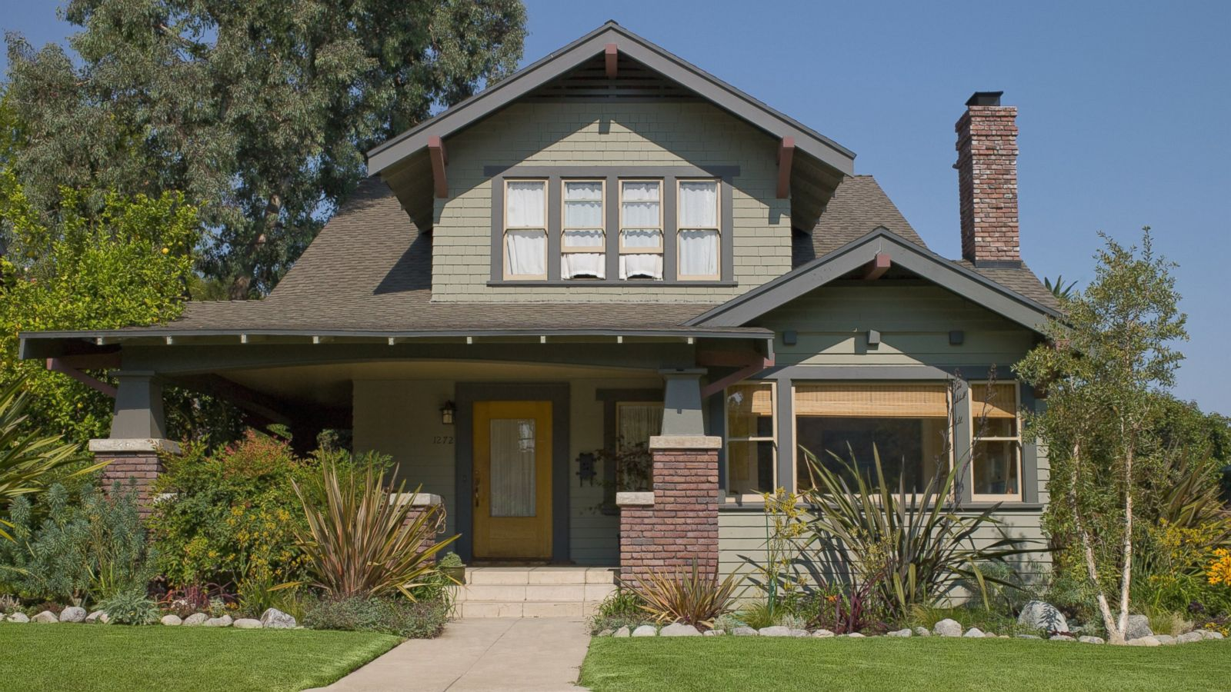
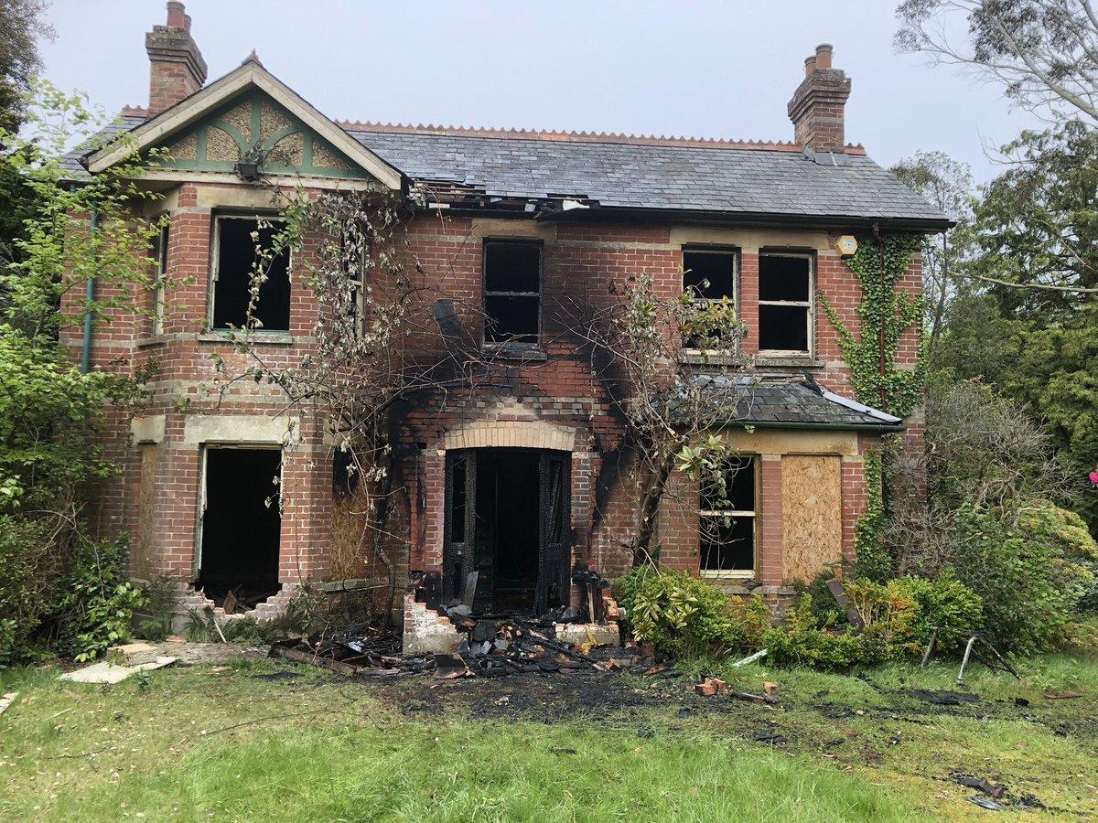

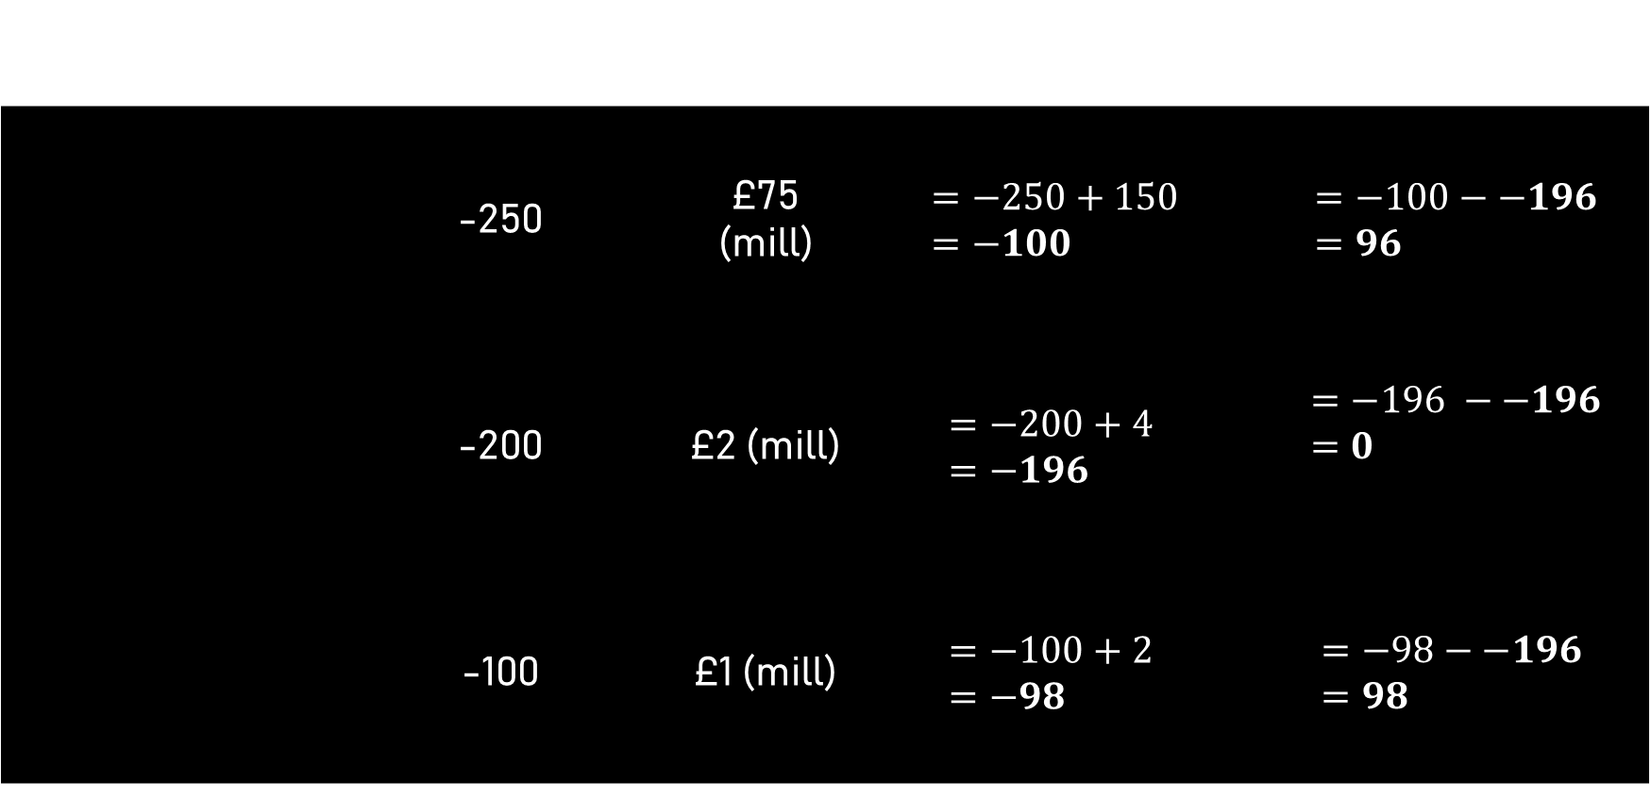
Let’s buy a house
The house | Deon’s Rating (-2lnL) | Cost (K) | AIC | ∆AIC
 | -250 | £75 (mill) | $$=−250+150 =−100$$ | $$=−100−−196=96$$
 | -200 | £2 (mill) | $$=−200+4 \\ =−196$$ | $$=−196 −−196=0$$
 | -100 | £1 (mill) | $$=−100+2 \\ =−98$$ | $$=−98−−196 =98$$
$$AIC=−2lnℒ+2K$$

Slide 10
Model selection with AIC
We select the model with the lowest AIC
This will be the model where ∆AIC = 0
Any models with ∆AIC > 2, we reject them
If there are models with ∆AIC < 2, both models are valid.
Some people argue to always choose the lowest
Other argue that you choose which one to use
No more p-values!

Slide 11
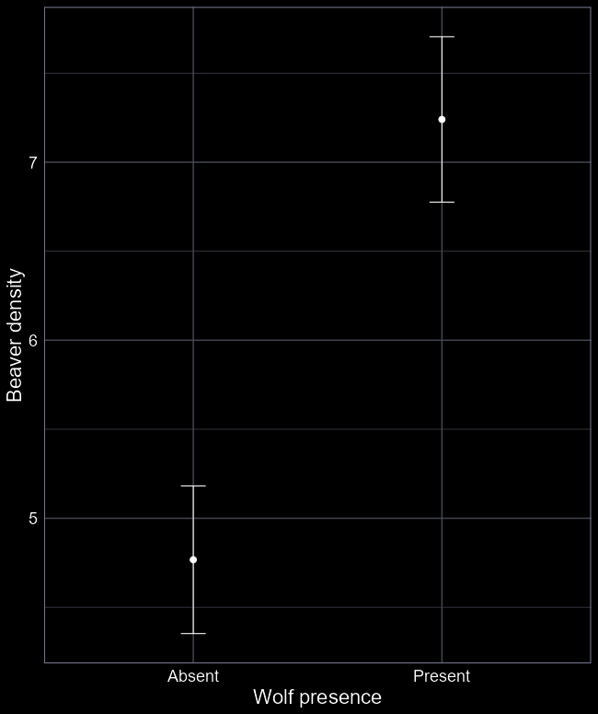
What does “best” mean?
AIC tells us the “most parsimonious model” or “best model”
Best is evaluated by finding the version of the model that most closely fits the data, as efficiently as possible
Evaluating predictive performance
I.e. which is the most accurate model
Meaning AIC is useful for making predictive model more efficient
Remember that confounding allows us to make very accurate predictions with no causation

Slide 12
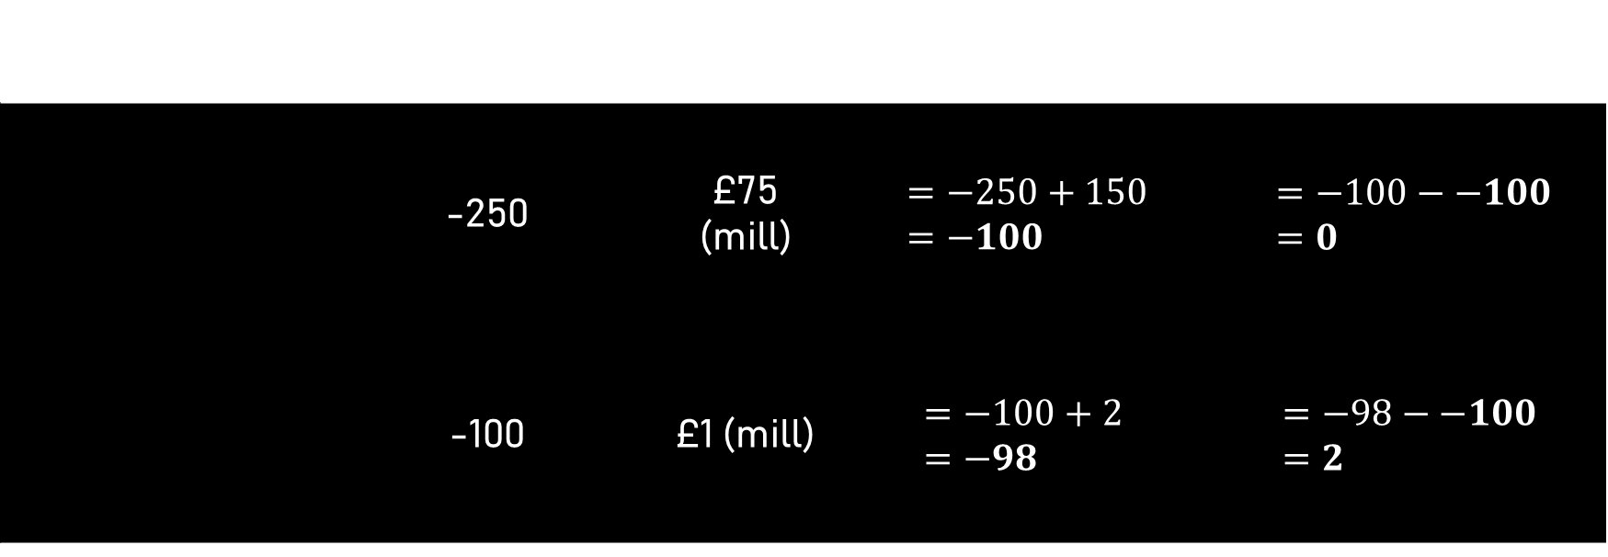

Which house do we choose now?
The house | Deon’s Rating (-2lnL) | Cost (K) | AIC | ∆AIC
 | -250 | £75 (mill) | $$=−250+150 =−100$$ | $$=−100−−100 \\ =0$$
 | -100 | £1 (mill) | $$=−100+2 \\ =−98$$ | $$=−98−−100 \\ =2$$
$$AIC=−2lnℒ+2K$$

Slide 13
tl;dr
We can use the MLE (the “rating”) of each model to find the most parsimonious model that was tested.
AIC attempts to optimise two features
How well the model captures the data
The number of parameters required to get that fit
The end result is an efficient predictive model
AIC does not help us understand causation
Because confounding often allows for highly accurate predictions

